Slide 1
Estudos de Caso
Motivação para a Rede Inception
Notes:
When designing a layer for a ConvNet, you might have to pick, do you want a 1 by 3 filter, or 3 by 3, or 5 by 5, or do you want a pooling layer? What the inception network does is it says, why should you do them all? And this makes the network architecture more complicated, but it also works remarkably well. Let's see how this works. Let's say for the sake of example that you have inputted a 28 by 28 by 192 dimensional volume. So what the inception network or what an inception layer says is, instead choosing what filter size you want in a Conv layer, or even do you want a convolutional layer or a pooling layer? Let's do them all. So what if you can use a 1 by 1 convolution, and that will output a 28 by 28 by something. Let's say 28 by 28 by 64 output, and you just have a volume there. But maybe you also want to try a 3 by 3 and that might output a 20 by 20 by 128. And then what you do is just stack up this second volume next to the first volume. And to make the dimensions match up, let's make this a same convolution. So the output dimension is still 28 by 28, same as the input dimension in terms of height and width. But 28 by 28 by in this example 128. And maybe you might say well I want to hedge my bets. Maybe a 5 by 5 filter works better. So let's do that too and have that output a 28 by 28 by 32. And again you use the same convolution to keep the dimensions the same. And maybe you don't want to convolutional layer. Let's apply pooling, and that has some other output and let's stack that up as well. And here pooling outputs 28 by 28 by 32. Now in order to make all the dimensions match, you actually need to use padding for max pooling. So this is an unusual formal pooling because if you want the input to have a higher than 28 by 28 and have the output, you'll match the dimension everything else also by 28 by 28, then you need to use the same padding as well as a stride of one for pooling. So this detail might seem a bit funny to you now, but let's keep going. And we'll make this all work later. But with a inception module like this, you can input some volume and output. In this case I guess if you add up all these numbers, 32 plus 32 plus 128 plus 64, that's equal to 256. So you will have one inception module input 28 by 28 by 129, and output 28 by 28 by 256. And this is the heart of the inception network which is due to Christian Szegedy, Wei Liu, Yangqing Jia, Pierre Sermanet, Scott Reed, Dragomir Anguelov, Dumitru Erhan, Vincent Vanhoucke and Andrew Rabinovich. And the basic idea is that instead of you needing to pick one of these filter sizes or pooling you want and committing to that, you can do them all and just concatenate all the outputs, and let the network learn whatever parameters it wants to use, whatever the combinations of these filter sizes it wants. Now it turns out that there is a problem with the inception layer as we've described it here, which is computational cost. On the next slide, let's figure out what's the computational cost of this 5 by 5 filter resulting in this block over here. So just focusing on the 5 by 5 pot on the previous slide, we had as input a 28 by 28 by 192 block, and you implement a 5 by 5 same convolution of 32 filters to output 28 by 28 by 32. On the previous slide I had drawn this as a thin purple slide. So I'm just going draw this as a more normal looking blue block here. So let's look at the computational costs of outputting this 20 by 20 by 32. So you have 32 filters because the outputs has 32 channels, and each filter is going to be 5 by 5 by 192. And so the output size is 20 by 20 by 32, and so you need to compute 28 by 28 by 32 numbers. And for each of them you need to do these many multiplications, right? 5 by 5 by 192. So the total number of multiplies you need is the number of multiplies you need to compute each of the output values times the number of output values you need to compute. And if you multiply all of these numbers, this is equal to 120 million. And so, while you can do 120 million multiplies on the modern computer, this is still a pretty expensive operation. On the next slide you see how using the idea of 1 by 1 convolutions, which you learnt about in the previous video, you'll be able to reduce the computational costs by about a factor of 10. To go from about 120 million multiplies to about one tenth of that. So please remember the number 120 so you can compare it with what you see on the next slide, 120 million. Here is an alternative architecture for inputting 28 by 28 by 192, and outputting 28 by 28 by 32, which is falling. You are going to input the volume, use a 1 by 1 convolution to reduce the volume to 16 channels instead of 192 channels, and then on this much smaller volume, run your 5 by 5 convolution to give you your final output. So notice the input and output dimensions are still the same. You input 28 by 28 by 192 and output 28 by 28 by 32, same as the previous slide. But what we've done is we're taking this huge volume we had on the left, and we shrunk it to this much smaller intermediate volume, which only has 16 instead of 192 channels. Sometimes this is called a bottleneck layer, right? I guess because a bottleneck is usually the smallest part of something, right? So I guess if you have a glass bottle that looks like this, then you know this is I guess where the cork goes. And then the bottleneck is the smallest part of this bottle. So in the same way, the bottleneck layer is the smallest part of this network. We shrink the representation before increasing the size again. Now let's look at the computational costs involved. To apply this 1 by 1 convolution, we have 16 filters. Each of the filters is going to be of dimension 1 by 1 by 192, this 192 matches that 192. And so the cost of computing this 28 by 28 by 16 volumes is going to be well, you need these many outputs, and for each of them you need to do 192 multiplications. I could have written 1 times 1 times 192, right? Which is this. And if you multiply this out, this is 2.4 million, it's about 2.4 million. How about the second? So that's the cost of this first convolutional layer. The cost of this second convolutional layer would be that well, you have these many outputs. So 28 by 28 by 32. And then for each of the outputs you have to apply a 5 by 5 by 16 dimensional filter. And so by 5 by 5 by 16. And you multiply that out is equals to 10.0. And so the total number of multiplications you need to do is the sum of those which is 12.4 million multiplications. And you compare this with what we had on the previous slide, you reduce the computational cost from about 120 million multiplies, down to about one tenth of that, to 12.4 million multiplications. And the number of additions you need to do is about very similar to the number of multiplications you need to do. So that's why I'm just counting the number of multiplications. So to summarize, if you are building a layer of a neural network and you don't want to have to decide, do you want a 1 by 1, or 3 by 3, or 5 by 5, or pooling layer, the inception module let's you say let's do them all, and let's concatenate the results. And then we run to the problem of computational cost. And what you saw here was how using a 1 by 1 convolution, you can create this bottleneck layer thereby reducing the computational cost significantly. Now you might be wondering, does shrinking down the representation size so dramatically, does it hurt the performance of your neural network? It turns out that so long as you implement this bottleneck layer so that within reason, you can shrink down the representation size significantly, and it doesn't seem to hurt the performance, but saves you a lot of computation. So these are the key ideas of the inception module. Let's put them together and in the next video show you what the full inception network looks like.

Slide 2
Motivação para a rede Inception
Quando você cria uma CNN, você tem que decidir sobre todas as camadas
Você escolherá uma Conv 3 x 3 ou Conv 5 x 5 ou talvez uma camada de max pooling
Você tem tantas escolhas!
O que a inception nos diz é: por que não usar todos eles de uma só vez?

Slide 3
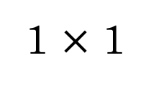
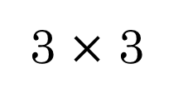
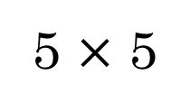
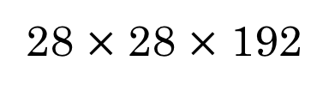
Motivação para a rede Inception
64
128
28
32
32
28
MAX-POOL
[Szegedy et al. 2014. Going deeper with convolutions]
Note: the colors are intended to correspond to the stacked small hand drawn cube

Slide 4
Motivação para a rede Inception
“same”, 64 filtros, s=1
“same”, 128 filtros, s=1
64
128
28
“same”, 32 filtros, s=1
32
32
28
MAX-POOL
“same”, s=1
[Szegedy et al. 2014. Going deeper with convolutions]
Note: the colors are intended to correspond to the stacked small hand drawn cube

Slide 5
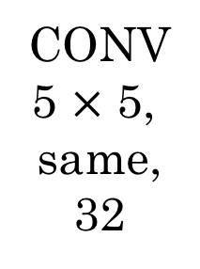
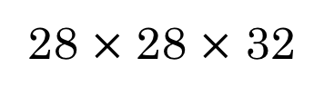
O problema do custo computacional
Número de multiplicações:
(28 * 28 * 32) * (5 * 5 * 192) = 120M!

Slide 6
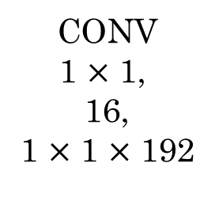
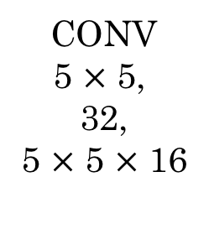
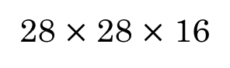
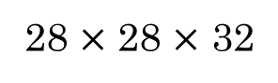
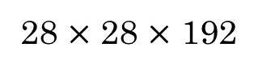
Usando convoluções 1x1
“bottleneck layer”
Número de multiplicações:
(28 * 28 * 16) * (1 * 1 * 192) = 2.4M
Número de multiplicações:
(28 * 28 * 32) * (5 * 5 * 16) = 10M
12.4M << 120M

Slide 7
Estudos de Caso
Inception network
(GoogLeNet)
Notes:
In a previous video, you've already seen all the basic
building blocks of the Inception network. In this video, let's see how you can
put these building blocks together to build your own Inception network. So the inception module takes
as input the activation or the output from some previous layer. So let's say for the sake of
argument this is 28 by 28 by 192, same as our previous video. The example we worked through in depth
was the 1 by 1 followed by 5 by 5. There, so
maybe the 1 by 1 has 16 channels and then the 5 by 5 will output a 28 by 28 by,
let's say, 32 channels. And this is the example we worked through
on the last slide of the previous video. Then to save computation on your 3 by 3
convolution you can also do the same here. And then the 3 by 3 outputs,
28 by 28 by 1 by 28. And then maybe you want to consider
a 1 by 1 convolution as well. There's no need to do a 1 by 1 conv
followed by another 1 by 1 conv so there's just one step here and
let's say these outputs 28 by 28 by 64. And then finally is the pulling layer. So here I'm going to do something funny. In order to really concatenate
all of these outputs at the end we are going to use the same
type of padding for pooling. So that the output height and
width is still 28 by 28. So we can concatenate it
with these other outputs. But notice that if you do max-pooling,
even with same padding, 3 by 3 filter is tried at 1. The output here will be 28 by 28, By 192. It will have the same
number of channels and the same depth as
the input that we had here. So, this seems like is
has a lot of channels. So what we're going to do is
actually add one more 1 by 1 conv layer to then to what we saw in
the one by one convilational video, to strengthen the number of channels. So it gets us down to 28
by 28 by let's say, 32. And the way you do that,
is to use 32 filters, of dimension 1 by 1 by 192. So that's why the output dimension has
a number of channels shrunk down to 32. So then we don't end up
with the pulling layer taking up all the channels
in the final output. And finally you take all of these blocks
and you do channel concatenation. Just concatenate across
this 64 plus 128 plus 32 plus 32 and
this if you add it up this gives you a 28 by 28 by 256 dimension output. Concat is just this concatenating the
blocks that we saw in the previous video. So this is one inception module, and
what the inception network does, is, more or less,
put a lot of these modules together. Here's a picture of the inception network,
taken from the paper by Szegedy et al And you notice a lot of
repeated blocks in this. Maybe this picture looks
really complicated. But if you look at one of the blocks
there, that block is basically the inception module that you
saw on the previous slide. And subject to little details I won't
discuss, this is another inception block. This is another inception block. There's some extra max pooling
layers here to change the dimension of the heightened width. But that's another inception block. And then there's another max put here
to change the height and width but basically there's another inception block. But the inception network is just a lot
of these blocks that you've learned about repeated to different
positions of the network. But so you understand the inception
block from the previous slide, then you understand the inception network. It turns out that there's one last detail
to the inception network if we read the optional research paper. Which is that there are these additional
side-branches that I just added. So what do they do? Well, the last few layers of
the network is a fully connected layer followed by a softmax layer
to try to make a prediction. What these side branches do is
it takes some hidden layer and it tries to use that to make a prediction. So this is actually a softmax output and
so is that. And this other side branch, again it is a hidden layer passes through
a few layers like a few connected layers. And then has the softmax try to
predict what's the output label. And you should think of this as maybe
just another detail of the inception that's worked. But what is does is it helps to
ensure that the features computed. Even in the heading units,
even at intermediate layers. That they're not too bad for
protecting the output cause of a image. And this appears to have a regularizing
effect on the inception network and helps prevent this
network from overfitting. And by the way,
this particular Inception network was developed by authors at Google. Who called it GoogleNet, spelled like
that, to pay homage to the network. That you learned about in
an earlier video as well. So I think it's actually really nice
that the Deep Learning Community is so collaborative. And that there's such
strong healthy respect for each other's' work in
the Deep Learning Learning community. FInally here's one fun fact. Where does the name
inception network come from? The inception paper actually cites
this meme for we need to go deeper. And this URL is an actual
reference in the inception paper, which links to this image. And if you've seen the movie
titled The Inception, maybe this meme will make sense to you. But the authors actually cite
this meme as motivation for needing to build deeper new networks. And that's how they came up with
the inception architecture. So I guess it's not often that research
papers get to cite Internet memes in their citations. But in this case,
I guess it worked out quite well. So to summarize,
if you understand the inception module, then you understand the inception network. Which is largely the inception
module repeated a bunch of times throughout the network. Since the development of the original
inception module, the author and others have built on it and
come up with other versions as well. So there are research papers on newer
versions of the inception algorithm. And you sometimes see people use
some of these later versions as well in their work, like inception v2,
inception v3, inception v4. There's also an inception version. This combined with the resonant
idea of having skipped connections, and that sometimes works even better. But all of these variations are built on
the basic idea that you learned about this in the previous video of coming
up with the inception module and then stacking up a bunch of them together. And with these videos you
should be able to read and understand, I think, the inception paper, as well as maybe some of the papers
describing the later derivation as well. So that's it, you've gone through quite a lot of
specialized neural network architectures. In the next video, I want to start showing
you some more practical advice on how you actually use these algorithms to build
your own computer vision system. Let's go on to the next video.

Slide 8
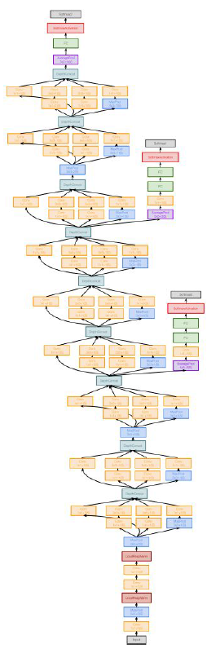
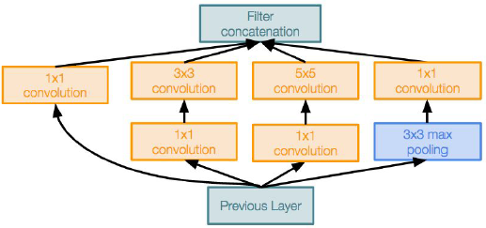
GoogLeNet
Redes mais profundas, mas com eficiência computacional
22 camadas
Módulo “Inception” (eficiente)
Sem camadas FC
“Apenas” 5M parâmetros
12x menos que a AlexNet
Vencedor da tarefa de classificação do ILSVRC´14 (6.7% top 5 error)
Módulo inception

Slide 9
GoogLeNet
“Módulo Inception”: projeto de uma boa topologia de rede local (network within network) e depois empilha esses módulos um em cima do outro
Módulo inception

Slide 10
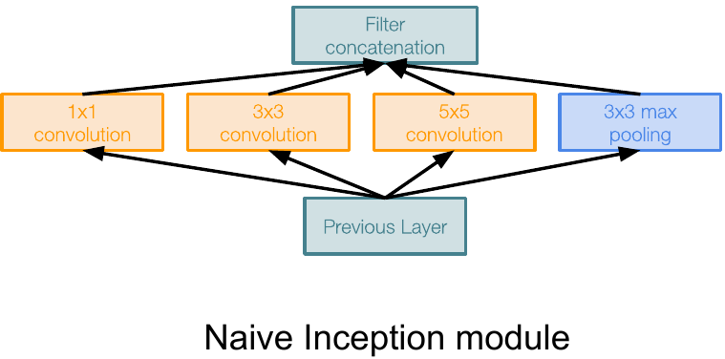
GoogLeNet
Aplica operações de filtros paralelas na entrada da camada anterior:
Múltiplos tamanhos de campos receptivos para convolução (1x1, 3x3, 5x5)
Operação de pooling (3x3)
Empilha (concatena) todas as saídas dos filtros juntos, “depth-wise”
Q: Qual é o problema disso?
Dica: complexidade computacional

Slide 11
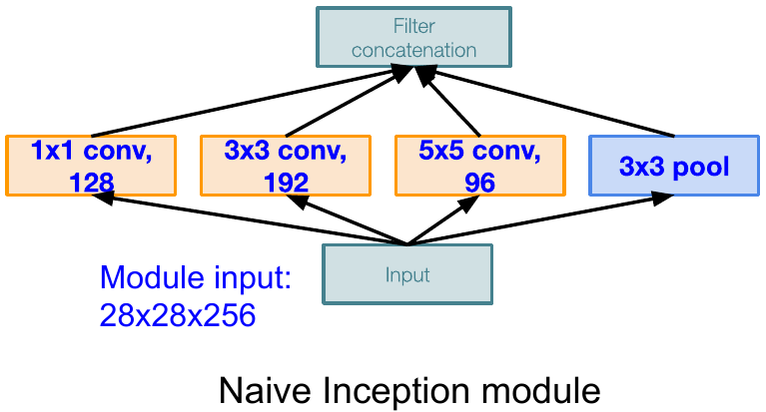
GoogLeNet
Q: Qual é o problema disso?
Dica: complexidade computacional
Q1: Qual é o tamanho de saída da conv 1x1, com 128 filtros?
Exemplo:

Slide 12
GoogLeNet
Q: Qual é o problema disso?
Dica: complexidade computacional
Q1: Qual é o tamanho de saída da conv 1x1, com 128 filtros?
A1: 28x28x128
Exemplo:
28x28x128

Slide 13
GoogLeNet
Q: Qual é o problema disso?
Dica: complexidade computacional
Q1: Qual é o tamanho de saída da conv 1x1, com 128 filtros?
Q2: Qual é o tamanho das outras saídas?
Exemplo:
28x28x128
28x28x192
28x28x96
28x28x256

Slide 14
GoogLeNet
Q: Qual é o problema disso?
Dica: complexidade computacional
Q1: Qual é o tamanho de saída da conv 1x1, com 128 filtros?
Q2: Qual é o tamanho das outras saídas?
Q3: Qual é o tamanho da saída depois da concatenação?
A3: 28x28x(28 + 192 + 96 + 256)
= 28x28x672
Exemplo:
28x28x672
28x28x128
28x28x192
28x28x96
28x28x256

Slide 15
GoogLeNet
Q1: Qual é o tamanho de saída da conv 1x1, com 128 filtros?
Q2: Qual é o tamanho das outras saídas?
Q3: Qual é o tamanho da saída depois da concatenação?
Q: Qual é o problema disso?
Dica: complexidade computacional
Número de operações (*) nas convs:
[1x1 conv, 128]: 28*28*128*1*1*256
[3x3 conv, 192]: 28*28*192*3*3*256
[5x5 conv, 96]: 28*28*96*5*5*256
Total: 854M multiplicações
Exemplo:
28x28x672
28x28x128
28x28x192
28x28x96
28x28x256

Slide 16
GoogLeNet
Q: Qual é o problema disso?
Dica: complexidade computacional
Número de operações (*) nas convs:
[1x1 conv, 128]: 28*28*128*1*1*256
[3x3 conv, 192]: 28*28*192*3*3*256
[5x5 conv, 96]: 28*28*96*5*5*256
Total: 854M multiplicações
Muito caro de computar
Camadas de pooling também preservam a profundidade do volume de entrada, então a profundidade de saída pode apenas aumentar
Exemplo:
28x28x672
28x28x128
28x28x192
28x28x96
28x28x256

Slide 17
GoogLeNet
Q: Qual é o problema disso?
Dica: complexidade computacional
Soulção: camadas “bottleneck” que usam convoluções 1x1 para reduzir a profundidade do volume de saída
Exemplo:
28x28x672
28x28x128
28x28x192
28x28x96
28x28x256

Slide 18
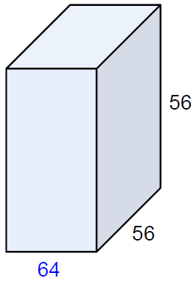
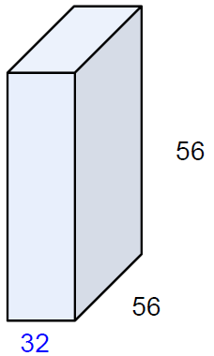
Lembrete: convoluções 1x1
(cada filtro tem tamanho 1x1x64, e executa um produto escalar de 64 dimensões

Slide 19
Lembrete: convoluções 1x1
preserva as dimensões espaciais, mas reduz a profundidade!
Projeta a profundidade em uma dimensão menor (combinação dos mapas de features)

Slide 20
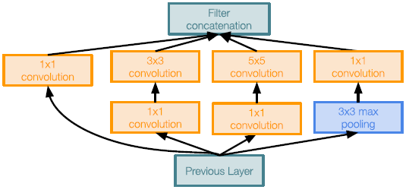
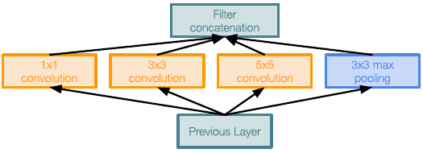
GoogLeNet
Módulo inception ingênuo
(naive inception module)
Módulo inception com redução de dimensionalidade

Slide 21
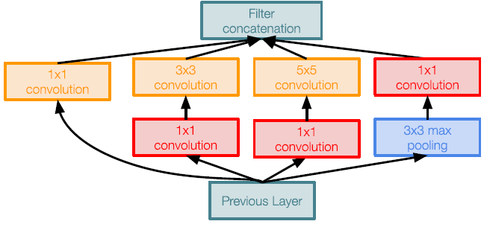
GoogLeNet
camadas 1x1 conv bottleneck
Módulo inception ingênuo
(naive inception module)
Módulo inception com redução de dimensionalidade

Slide 22
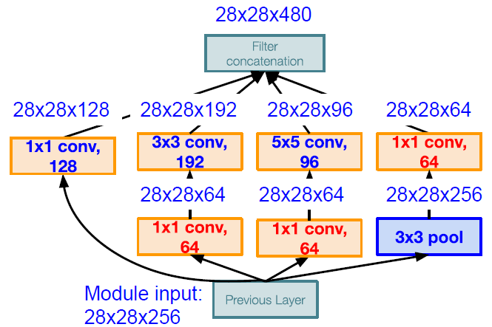
GoogLeNet
Número de operações (*) nas convs:
[1x1 conv, 64]: 28*28*64*1*1*256
[1x1 conv, 64]: 28*28*64*1*1*256
[1x1 conv, 128]: 28*28*128*1*1*256
[3x3 conv, 192]: 28*28*192*3*3*64
[5x5 conv, 96]: 28*28*96*5*5*64
[1x1 conv, 64]: 28*28*64*1*1*256
Total: 358M operações
Bem menos, comparado com as 854M de operações da versão ingênua
Também pode reduzir a profundidade depois da camada de pooling
Módulo inception com redução de dimensionalidade

Slide 23
GoogLeNet
Empilha módulos “inception” com redução de dimensionalidade um em cima do outro
Módulo inception

Slide 24
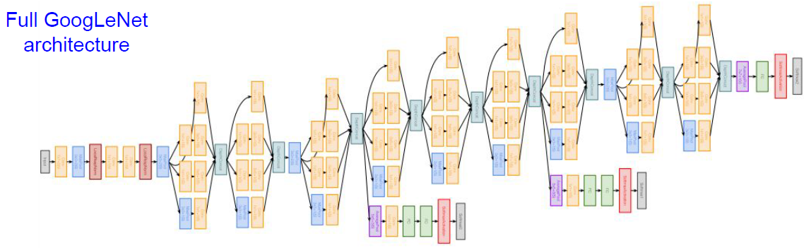
GoogLeNet
Traditional CNN:
CONV-Pool-CONV-CONV-Pool

Slide 25
GoogLeNet
Módulos “Inception” empilhados

Slide 26
GoogLeNet
Nota: depois da última camada de convolução, uma camada de average pooling global é usada para calcular a média entre todos os mapas de features, antes da última camada FC. Não precisamos mais de múltiplas camadas FCs, o que é muito caro!
Saída do classificador
Notes:
O avg. pooling é feito sobre todo o mapa de ativação!
https://alexisbcook.github.io/2017/global-average-pooling-layers-for-object-localization/

Slide 27
GoogLeNet
Saídas de classificação auxiliares para injetar gradientes adicionais em camadas mais baixas (AvgPool-1x1Conv-FC-FC-Softmax)
Notes:
Mais detalhes sobre como os pesos são atualizados considerando as saídas de classificação auxiliares: https://towardsdatascience.com/a-simple-guide-to-the-versions-of-the-inception-network-7fc52b863202

Slide 28
GoogLeNet
22 camadas no total com pesos (parâmetros):
camadas paralelas contam como 1 camada -> 2 camadas por módulo Inception
Não conte camadas de saída auxiliares

Slide 29
GoogLeNet
Redes mais profundas, mas com eficiência computacional
22 camadas
Módulo “Inception” (eficiente)
Sem camadas FC
“Apenas” 5M parâmetros
12x menos que a AlexNet
Vencedor da tarefa de classificação do ILSVRC´14 (6.7% top 5 error)
Módulo inception

Slide 30
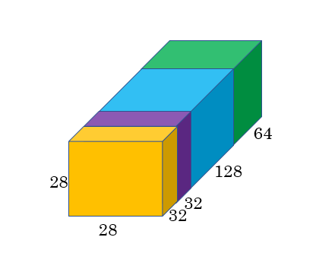
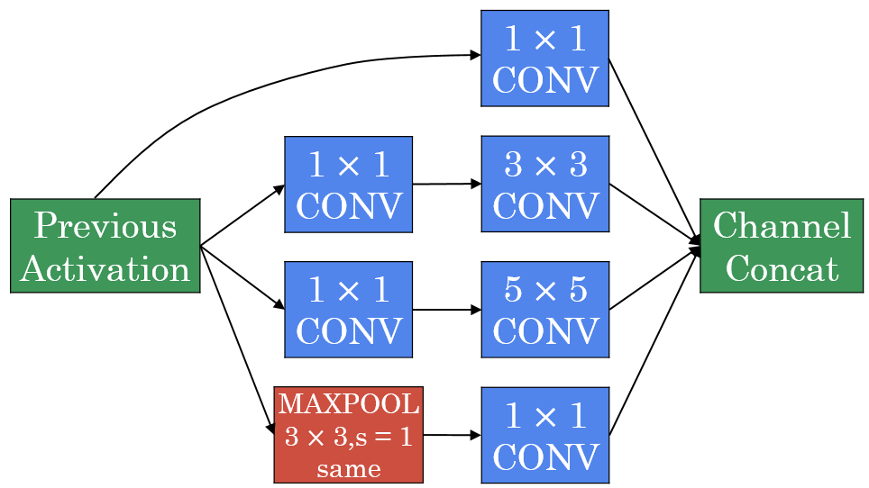
Inception module

Slide 31
Módulo Inception
Dica: o max-pooling é do tipo “same” aqui
A entrada para o módulo inception é 28 x 28 x 192 e a saída é 28 x 28 x 256
Faremos todos os Convs e pools que podemos querer e deixaremos a NN aprender e decidir qual deles quer usar mais
[Szegedy et al. 2014. Going deeper with convolutions]

Slide 32
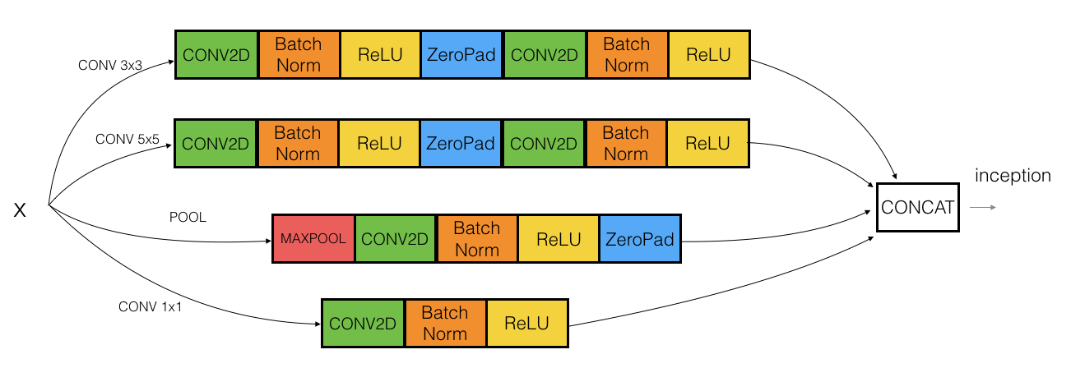
Exemplo em Keras
Notes:
https://www.kdnuggets.com/2018/09/dropout-convolutional-networks.html
https://towardsdatascience.com/batch-normalization-in-neural-networks-1ac91516821c

Slide 33
Rede inception (GoogleNet)
A rede Inception consiste em blocos concatenados do módulo Inception
O início do nome foi tirado de uma imagem memética tirada do filme Inception

Slide 34

http://knowyourmeme.com/memes/we-need-to-go-deeper

Slide 35
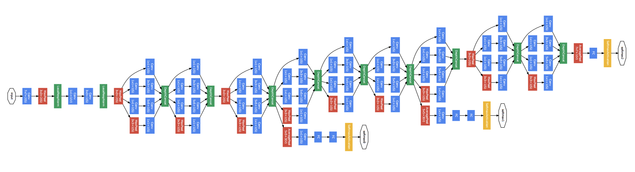


Rede inception
[Szegedy et al., 2014, Going Deeper with Convolutions]

Slide 36
Rede inception
Algumas vezes, um bloco Max-Pool é usado antes do módulo de início para reduzir as dimensões das entradas
Existem 3 blocos Softmax em diferentes posições para levar a rede ao seu objetivo
Ajuda a garantir que as features intermediárias sejam boas o suficiente para a rede aprender
Efeito colateral: softmax0 e sofmax1 também tem efeito de regularização
Existem outras versões dessa rede, inception v2, v3 e v4
Também existe uma rede que usou o módulo inception e a ResNet juntos

Slide 37
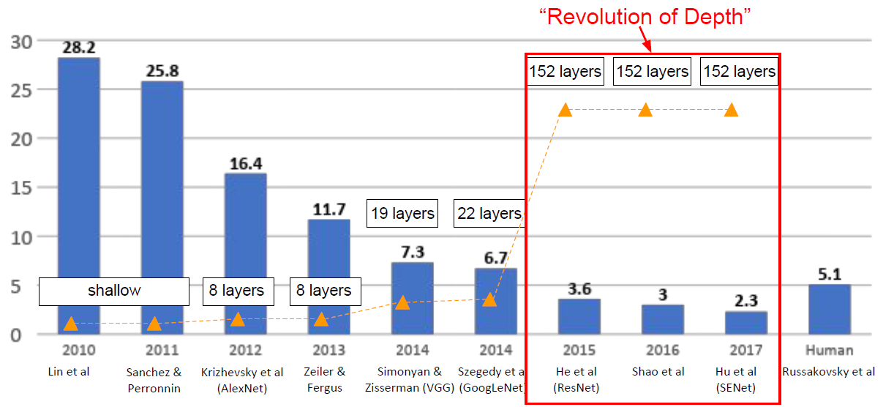
ImageNet Challenge (vencedores)

Slide 38
Estudos de Caso
Redes Residuais (ResNets)
Notes:
Very, very deep neural networks are difficult to train because of vanishing and exploding gradient types of problems. In this video, you'll learn about skip connections which allows you to take the activation from one layer and suddenly feed it to another layer even much deeper in the neural network. And using that, you'll build ResNet which enables you to train very, very deep networks. Sometimes even networks of over 100 layers. Let's take a look. ResNets are built out of something called a residual block, let's first describe what that is. Here are two layers of a neural network where you start off with some activations in layer a[l], then goes a[l+1] and then deactivation two layers later is a[l+2]. So let's to through the steps in this computation you have a[l], and then the first thing you do is you apply this linear operator to it, which is governed by this equation. So you go from a[l] to compute z[l +1] by multiplying by the weight matrix and adding that bias vector. After that, you apply the ReLU nonlinearity, to get a[l+1]. And that's governed by this equation where a[l+1] is g(z[l+1]). Then in the next layer, you apply this linear step again, so is governed by that equation. So this is quite similar to this equation we saw on the left. And then finally, you apply another ReLU operation which is now governed by that equation where G here would be the ReLU nonlinearity. And this gives you a[l+2]. So in other words, for information from a[l] to flow to a[l+2], it needs to go through all of these steps which I'm going to call the main path of this set of layers. In a residual net, we're going to make a change to this. We're going to take a[l], and just first forward it, copy it, match further into the neural network to here, and just at a[l], before applying to non-linearity, the ReLU non-linearity. And I'm going to call this the shortcut. So rather than needing to follow the main path, the information from a[l] can now follow a shortcut to go much deeper into the neural network. And what that means is that this last equation goes away and we instead have that the output a[l+2] is the ReLU non-linearity g applied to z[l+2] as before, but now plus a[l]. So, the addition of this a[l] here, it makes this a residual block. And in pictures, you can also modify this picture on top by drawing this picture shortcut to go here. And we are going to draw it as it going into this second layer here because the short cut is actually added before the ReLU non-linearity. So each of these nodes here, whwre there applies a linear function and a ReLU. So a[l] is being injected after the linear part but before the ReLU part. And sometimes instead of a term short cut, you also hear the term skip connection, and that refers to a[l] just skipping over a layer or kind of skipping over almost two layers in order to process information deeper into the neural network. So, what the inventors of ResNet, so that'll will be Kaiming He, Xiangyu Zhang, Shaoqing Ren and Jian Sun. What they found was that using residual blocks allows you to train much deeper neural networks. And the way you build a ResNet is by taking many of these residual blocks, blocks like these, and stacking them together to form a deep network. So, let's look at this network. This is not the residual network, this is called as a plain network. This is the terminology of the ResNet paper. To turn this into a ResNet, what you do is you add all those skip connections although those short like a connections like so. So every two layers ends up with that additional change that we saw on the previous slide to turn each of these into residual block. So this picture shows five residual blocks stacked together, and this is a residual network. And it turns out that if you use your standard optimization algorithm such as a gradient descent or one of the fancier optimization algorithms to the train or plain network. So without all the extra residual, without all the extra short cuts or skip connections I just drew in. Empirically, you find that as you increase the number of layers, the training error will tend to decrease after a while but then they'll tend to go back up. And in theory as you make a neural network deeper, it should only do better and better on the training set. Right. So, the theory, in theory, having a deeper network should only help. But in practice or in reality, having a plain network, so no ResNet, having a plain network that is very deep means that all your optimization algorithm just has a much harder time training. And so, in reality, your training error gets worse if you pick a network that's too deep. But what happens with ResNet is that even as the number of layers gets deeper, you can have the performance of the training error kind of keep on going down. Even if we train a network with over a hundred layers. And then now some people experimenting with networks of over a thousand layers although I don't see that it used much in practice yet. But by taking these activations be it X of these intermediate activations and allowing it to go much deeper in the neural network, this really helps with the vanishing and exploding gradient problems and allows you to train much deeper neural networks without really appreciable loss in performance, and maybe at some point, this will plateau, this will flatten out, and it doesn't help that much deeper and deeper networks. But ResNet is not even effective at helping train very deep networks. So you've now gotten an overview of how ResNets work. And in fact, in this week's programming exercise, you get to implement these ideas and see it work for yourself. But next, I want to share with you better intuition or even more intuition about why ResNets work so well, let's go onto the next video.

Slide 39
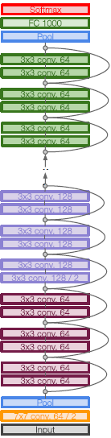
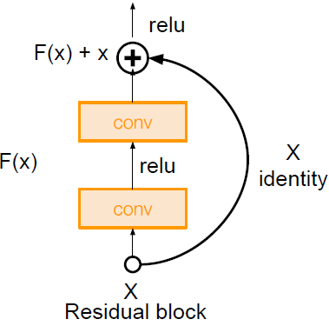
ResNets
Redes muito profundas usando conexões residuais
Modelo de 152 camadas para o ImageNet
Venceu o ILSVRC’15 (classificação) com 3.57% de top 5 error
Venceu todas as tarefas de classificação e detecção tanto no ILSVRC’15 e COCO’15

Slide 40
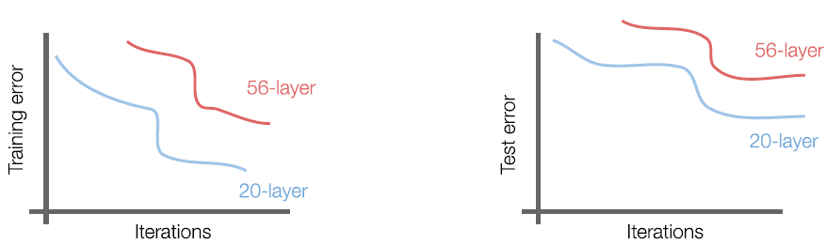
ResNets
O que acontece quando continuamos a empilhar camadas mais profundas em uma CNN?
Q: O que tem de estranho com essas curvas?
A: O modelo de 56 camadas é pior tanto no treino quanto no erro.

Slide 41
ResNets
O que acontece quando continuamos a empilhar camadas mais profundas em uma CNN?
O modelo de 56 camadas é pior tanto no treino quanto no erro.
Q: O que isso significa?
A: O problema não é overfitting!

Slide 42
ResNets
Hipótese: o problema é a otimização
Modelos mais profundos são mais difíceis de otimizar
Modelos mais profundos deveriam ser pelo menos tão bons
Prova por construção: considere um modelo com K camadas, e adicione uma camada extra que faça apenas um identity mapping

Slide 43
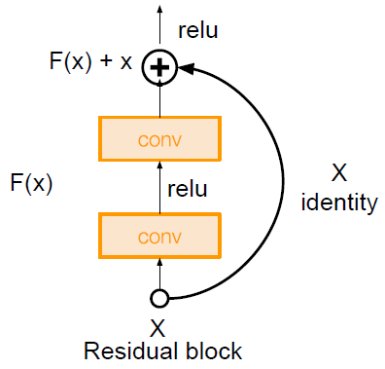
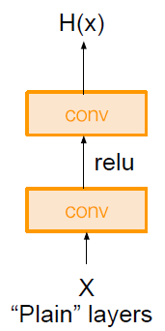
ResNets
Solução: Use as camadas da rede para ajustar um mapa residual ao invés de diretamente tentar ajustar o mapeamento subjacente desejado
Use as camadas para ajustar os resíduos F(x)=H(x)-x ao invés de H(x) diretamente
H(x) = F(x) + x

Slide 44
ResNets
Arquitetura completa:
Empilhe blocos residuais
Cada bloco residual tem duas camadas CONV 3x3

Slide 45
ResNets
Arquitetura completa:
Empilhe blocos residuais
Cada bloco residual tem duas camadas CONV 3x3
Periodicamente dobre o # de filtros e reduza o tamanho espacial usando stride 2 (/2 em cada dimensão)
3x3 CONV, 128 filtros, /2 espacialmente com stride 2
3x3 CONV, 64 filtros

Slide 46
ResNets
Arquitetura completa:
Empilhe blocos residuais
Cada bloco residual tem duas camadas CONV 3x3
Periodicamente dobre o # de filtros e reduza o tamanho espacial usando stride 2 (/2 em cada dimensão)
Camada CONV adicional no começo
Camada CONV no começo

Slide 47
ResNets
Arquitetura completa:
Empilhe blocos residuais
Cada bloco residual tem duas camadas CONV 3x3
Periodicamente dobre o # de filtros e reduza o tamanho espacial usando stride 2 (/2 em cada dimensão)
Camada CONV adicional no começo
Sem camadas FC no final (apenas FC 1000 para as classes finais)
Sem camadas FC, apenas a FC 1000 para as classes finais
Camada de pooling médio depois da última camada CONV

Slide 48
ResNets
Para o ImageNet, foram testadas profundidades de 34, 50, 101 e 152 camadas

Slide 49
ResNets
Para redes mais profundas (ResNet-50+), use uma camada “bottleneck” para melhorar a eficiência

Slide 50
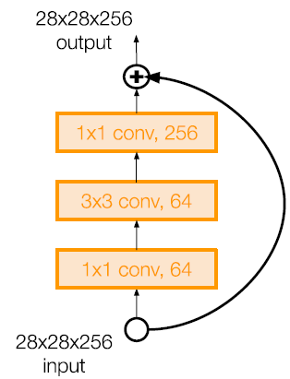
ResNets
Para redes mais profundas (ResNet-50+), use uma camada “bottleneck” para melhorar a eficiência
1x1 CONV, 256 filtros, projetam de volta para 256 mapas de features 28x28x256
3x3 CONV opera sobre apenas 64 mapas de features
1x1 CONV, 64 filtros para projetar em 28x28x64

Slide 51
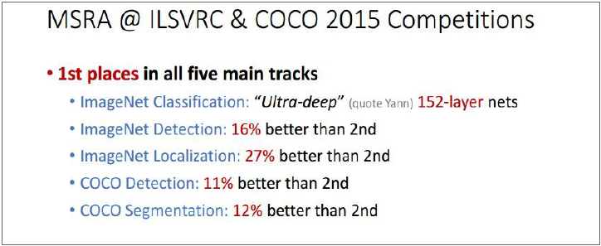
ResNEts
Resultados experimentais
Capazes de treinar redes muito profundas sem perda de desempenho
152 camadas no ImageNet, 1202 no Cifar
Redes mais profundas alcançam erro no treino menor, como esperado
Primeiros lugares em todas competições (2015)
ILSVRC 2015: 3.6% de erro - melhor que performance humana [Russakovsky 2014]

Slide 52
Redes residuais
NNs muito, muito profundas são difíceis de treinar por causa do problema de desaparecimento e explosão de gradientes
Para resolver isso, aprenderemos sobre a conexão skip
Pega a ativação de uma camada e a alimenta para outra camada
Permite treinar NNs grandes, mesmo com camadas maiores que 100

Slide 53
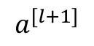
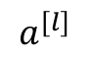
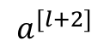
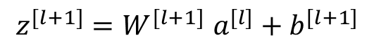
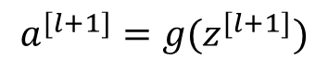
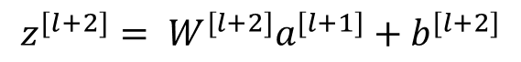
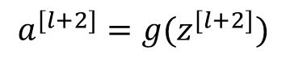
Bloco residual
[He et al., 2015. Deep residual networks for image recognition]

Slide 54
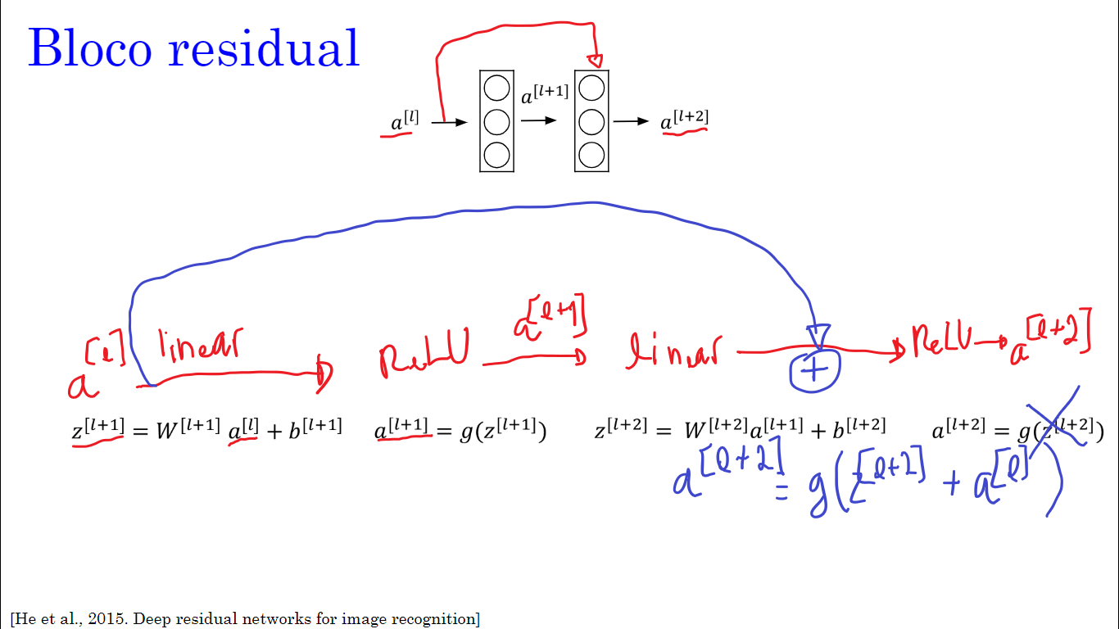

Slide 55
Blocos residuais
ResNets são compostas de blocos residuais
Eles adicionam uma conexão de atalho/salto (shortcut/skip) antes da segunda ativação
Os autores deste bloco propõem que você pode treinar NNs mais profundas usando o empilhamento destes blocos
[He et al., 2015. Deep residual networks for image recognition]

Slide 56
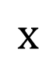
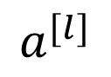
Rede Residual
Plain
ResNet
training error
training error
# layers
# layers
[He et al., 2015. Deep residual networks for image recognition]

Slide 57
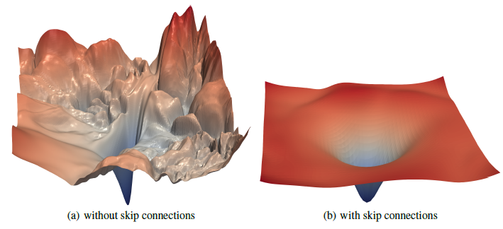
Superfícies das funções de perda
Li, Hao, et al. "Visualizing the loss landscape of neural nets." Advances in Neural Information Processing Systems. 2018.

Slide 58
Rede residual
São redes compostas de alguns blocos residuais
Essas redes podem se aprofundar sem prejudicar o desempenho
Nas redes normais, a teoria nos diz que, se nos aprofundarmos, obteremos uma solução melhor para o nosso problema
No entanto, por causa dos problemas de gradientes que desaparecem e explodem, o desempenho da rede sofre à medida que se aprofunda
Graças à Rede Residual, podemos ir mais fundo como queremos agora

Slide 59
Rede residual
O desempenho do ResNet aumenta à medida que a rede se aprofunda
Em alguns casos, ir mais fundo não afeta o desempenho e isso depende do problema em sua mão
Algumas pessoas estão tentando treinar redes com 1000 camadas, que por enquanto ainda não são usadas na prática

Slide 60
Estudos de Caso
Por que ResNets funcionam?
Notes:
So, why do ResNets work so well? Let's go through one example that illustrates why ResNets work so well, at least in the sense of how you can make them deeper and deeper without really hurting your ability to at least get them to do well on the training set. And hopefully as you've understood from the third course in this sequence, doing well on the training set is usually a prerequisite to doing well on your hold up or on your depth or on your test sets. So, being able to at least train ResNet to do well on the training set is a good first step toward that. Let's look at an example. What we saw on the last video was that if you make a network deeper, it can hurt your ability to train the network to do well on the training set. And that's why sometimes you don't want a network that is too deep. But this is not true or at least is much less true when you training a ResNet. So let's go through an example. Let's say you have X feeding in to some big neural network and just outputs some activation a[l]. Let's say for this example that you are going to modify the neural network to make it a little bit deeper. So, use the same big NN, and this output's a[l], and we're going to add a couple extra layers to this network so let's add one layer there and another layer there. And just for output a[l+2]. Only let's make this a ResNet block, a residual block with that extra short cut. And for the sake our argument, let's say throughout this network we're using the value activation functions. So, all the activations are going to be greater than or equal to zero, with the possible exception of the input X. Right. Because the value activation output's numbers that are either zero or positive. Now, let's look at what's a[l+2] will be. To copy the expression from the previous video, a[l+2] will be value apply to z[l+2], and then plus a[l] where is this addition of a[l] comes from the short circle from the skip connection that we just added. And if we expand this out, this is equal to g of w[l+2], times a of [l+1], plus b[l+2]. So that's z[l+2] is equal to that, plus a[l]. Now notice something, if you are using L two regularisation away to K, that will tend to shrink the value of w[l+2]. If you are applying way to K to B that will also shrink this although I guess in practice sometimes you do and sometimes you don't apply way to K to B, but W is really the key term to pay attention to here. And if w[l+2] is equal to zero. And let's say for the sake of argument that B is also equal to zero, then these terms go away because they're equal to zero, and then g of a[l], this is just equal to a[l] because we assumed we're using the value activation function. And so all of the activations are all negative and so, g of a[l] is the value applied to a non-negative quantity, so you just get back, a[l]. So, what this shows is that the identity function is easy for residual block to learn. And it's easy to get a[l+2] equals to a[l] because of this skip connection. And what that means is that adding these two layers in your neural network, it doesn't really hurt your neural network's ability to do as well as this simpler network without these two extra layers, because it's quite easy for it to learn the identity function to just copy a[l] to a[l+2] using despite the addition of these two layers. And this is why adding two extra layers, adding this residual block to somewhere in the middle or the end of this big neural network it doesn't hurt performance. But of course our goal is to not just not hurt performance, is to help performance and so you can imagine that if all of these heading units if they actually learned something useful then maybe you can do even better than learning the identity function. And what goes wrong in very deep plain nets in very deep network without this residual of the skip connections is that when you make the network deeper and deeper, it's actually very difficult for it to choose parameters that learn even the identity function which is why a lot of layers end up making your result worse rather than making your result better. And I think the main reason the residual network works is that it's so easy for these extra layers to learn the identity function that you're kind of guaranteed that it doesn't hurt performance and then a lot the time you maybe get lucky and then even helps performance. At least is easier to go from a decent baseline of not hurting performance and then great in decent can only improve the solution from there. So, one more detail in the residual network that's worth discussing which is through this edition here, we're assuming that z[l+2] and a[l] have the same dimension. And so what you see in ResNet is a lot of use of same convolutions so that the dimension of this is equal to the dimension I guess of this layer or the outputs layer. So that we can actually do this short circle connection, because the same convolution preserve dimensions, and so makes that easier for you to carry out this short circle and then carry out this addition of two equal dimension vectors. In case the input and output have different dimensions so for example, if this is a 128 dimensional and Z or therefore, a[l] is 256 dimensional as an example. What you would do is add an extra matrix and then call that Ws over here, and Ws in this example would be a[l] 256 by 128 dimensional matrix. So then Ws times a[l] becomes 256 dimensional and this addition is now between two 256 dimensional vectors and there are few things you could do with Ws, it could be a matrix of parameters we learned, it could be a fixed matrix that just implements zero paddings that takes a[l] and then zero pads it to be 256 dimensional and either of those versions I guess could work. So finally, let's take a look at ResNets on images. So these are images I got from the paper by Harlow. This is an example of a plain network and in which you input an image and then have a number of conv layers until eventually you have a softmax output at the end. To turn this into a ResNet, you add those extra skip connections. And I'll just mention a few details, there are a lot of three by three convolutions here and most of these are three by three same convolutions and that's why you're adding equal dimension feature vectors. So rather than a fully connected layer, these are actually convolutional layers but because the same convolutions, the dimensions are preserved and so the z[l+2] plus a[l] by addition makes sense. And similar to what you've seen in a lot of NetRes before, you have a bunch of convolutional layers and then there are occasionally pulling layers as well or pulling a pulling likely is. And whenever one of those things happen, then you need to make an adjustment to the dimension which we saw on the previous slide. You can do of the matrix Ws, and then as is common in these networks, you have <unknown> pool, and then at the end you now have a fully connected layer that then makes a prediction using a softmax. So that's it for ResNet. Next, there's a very interesting idea behind using neural networks with one by one filters, one by one convolutions. So, one could use a one by one convolution. Let's take a look at the next video.

Slide 61
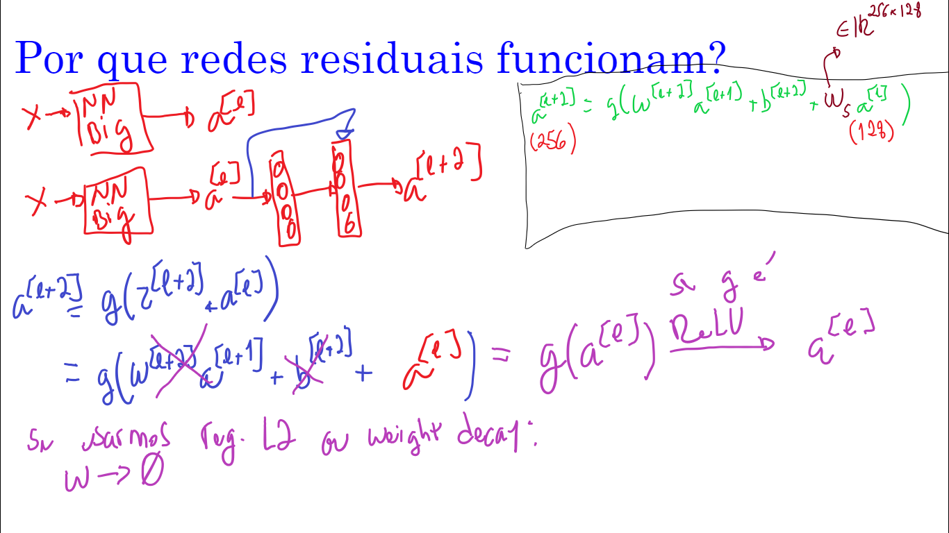

Slide 62
Por que redes residuais funcionam?
O quão difícil é fazer uma camada (FC ou Conv) aprender uma função identidade?
Notes:
No caso de FC, W é uma matriz identidade. No caso de Conv, é mais complicado ainda.

Slide 63
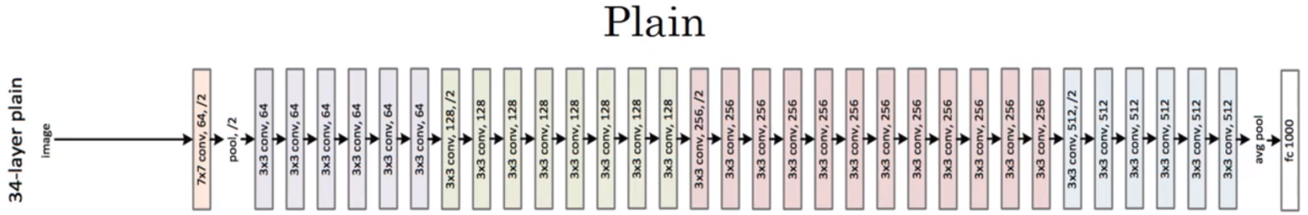
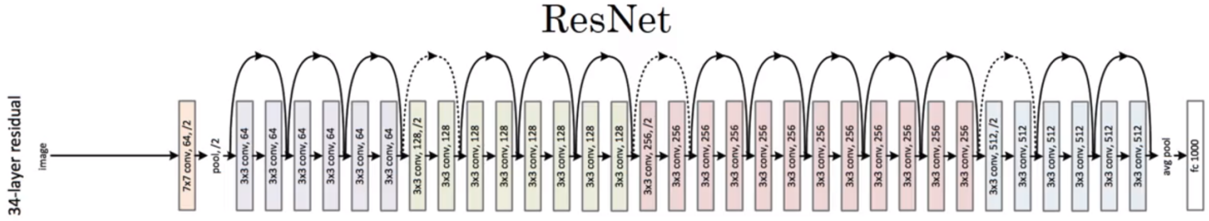
ResNet

Slide 64
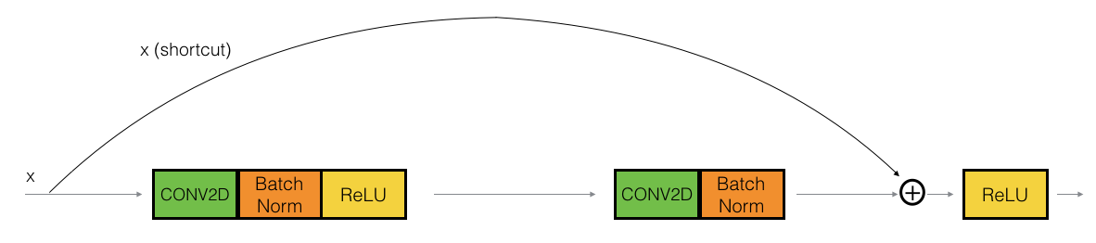
Bloco identidade (“identity”)
A conv é seguida por um BN antes da RELU. Dimensões aqui são as mesmas.
O skip é dado sobre 2 camadas
A conexão de salto pode saltar n conexões onde n > 2
Este desenho representa camadas no Keras

Slide 65
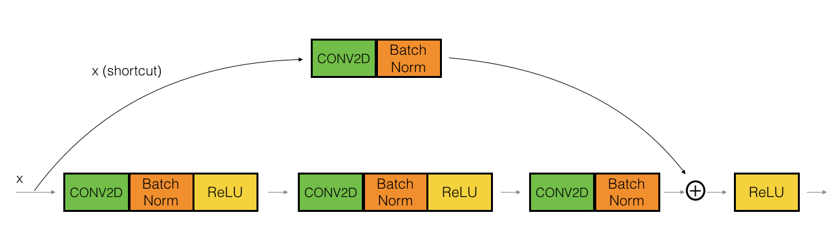
Bloco convolucional (“convolutional”)
A conv pode ser um bottleneck 1x1 conv

Slide 66

Conceito útil
Fonte: icml.cc/2016/tutorials/icml2016_tutorial_deep_residual_networks_kaiminghe.pdf

Slide 67


Slide 68
Para explorar
Chu, Brian, Daylen Yang, and Ravi Tadinada. "Visualizing residual networks." arXiv preprint arXiv:1701.02362 (2017).

Slide 69
Avisos práticos ao usar ConvNets
Comparação entre arquiteturas

Slide 70

Comparação

Slide 71
Comparação
Inception-v4: ResNet + Inception

Slide 72
Comparação
VGG: maior uso de memória, mais operações

Slide 73
Comparação
GoogLeNet: mais eficiente

Slide 74
Comparação
AlexNet: baixo # de operações, mas pesado em memória e baixa acurácia

Slide 75
Comparação
ResNet: eficiência moderada dependendo do modelo, alta acurácia

Slide 76

Comparação

Slide 77


Slide 78


Slide 79


Slide 80


Slide 81


Slide 82


Slide 83


Slide 84


Slide 85


Slide 86


Slide 87


Slide 88


Slide 89


Slide 90


Slide 91


Slide 92


Slide 93


Slide 94


Slide 95


Slide 96


Slide 97


Slide 98


